Slide 1
3D Game Basic
27th class
Optimization
Handityo aulia putra

Slide 2
Theories

Slide 3
Games Components
Components that construct a game:
Audio assets
2D and 3D graphical assets
Text and other file assets
Scripts

Slide 4
Processing in Games
When a game is running, there are many competing processing requirements for CPU and GPU, including:
Audio processing
Script processing
2D physics processing
3D physics processing
Graphical rendering
GPU processing

Slide 5
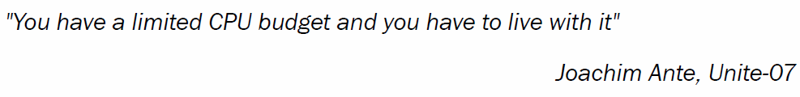
CPU Processing is Limited

Slide 6
Reducing Game Processing
Several methods to reduce the complexity of graphical computations and to improve frame rates are:
To use simpler models whenever possible
Level of Details (LOD) – for far object
reducing the triangle/vertex geometry

Slide 7
OPTIMIZATION

Slide 8
OPTIMIZATION
Optimization principals:
Minimize the number of active and enabled objects in a scene
Minimize actions requiring Unity to perform “reflection” over objects and searching of all current scene objects
Call methods as few times as possible
Use performance data to drive design and coding decisions
Minimize the number of draw calls

Slide 9
Optimization 1: Minimize the number of active and enabled objects in a scene
Reducing the number of objects by destroying objects at death a time
Reducing the number of enabled objects by disabling objects whenever possible
Reducing the number of active objects by making objects inactive whenever possible

Slide 10
Optimization 2: Minimize actions requiring Unity to perform “reflection” over objects and searching of all current scene objects
Improving efficiency with delegates and events and avoiding SendMessage!
Cache GameObject and component references to avoid expensive lookups

Slide 11
Optimization 3: Call methods as few times as possible
Executing methods regularly but independent of frame rate with coroutines
Spreading long computations over several frames with coroutines

Slide 12
Optimization 4: Use performance data to drive design and coding decisions
Evaluating performance by measuring max and min frame rates (FPS)
Identifying performance bottlenecks with the Unity performance Profiler
Identifying performance "bottlenecks" with Do-It-Yourself performance profiling

Slide 13
Optimization 5: Minimize the number of draw calls
Improving performance with LOD groups
Improving performance through reduced draw calls by designing for draw call batching

Slide 14
Optimization 1
Minimize the number of active and enabled objects in a scene

Slide 15
1A. Reducing the number of objects by destroying objects at death a time
One way to reduce the number of active objects is to
destroy objects when they are no longer needed.
As soon as an object is no longer needed, we should destroy it;
this saves both memory and processing resources
Unity no longer needs to send the object such messages as Update() and FixedUpdate(), or consider object collisions or physics and so on.

Slide 16
1A. Reducing the number of objects by destroying objects at death a time
However,
there may be times when
we wish not to destroy an object immediately, but at some known point in the future.
Examples might include
after a sound has finished playing, the player only has a certain time to collect a bonus object before it disappears,
an object displaying a message to the player should disappear after a certain time.

Slide 17
1B. Reducing the number of enabled objects by disabling objects whenever possible
Sometimes, we may not want to completely remove an object, but we can identify times when a scripted component of an object can be safely disabled.
If a MonoBehaviour script is disabled,
then Unity no longer needs to send the object messages, such as Update()and FixedUpdate(), for each frame.

Slide 18
1B. Reducing the number of enabled objects by disabling objects whenever possible
For example,
if a Non-Player Character (NPC) should only demonstrate some behavior when the player can see that character,
then we only need to be executing the behavior logic when the NPC is visible—
the rest of the time, we can safely disable the scripted component.

Slide 19
1B. Reducing the number of enabled objects by disabling objects whenever possible
Unity provides the very useful events
OnBecameInvisible() and
OnBecameVisible(),
which inform an object when it moves out of and into the visible area for one or more cameras in the scene.

Slide 20
1B. Reducing the number of enabled objects by disabling objects whenever possible - additional
Note – viewable in Scene panel still counts as visible!
Note that even if the Game panel is not showing (rendering) an object,
if the object is visible in a Scene panel, then it will still be considered visible.
Therefore, it is recommended that you hide/close the Scene panel when testing this recipe, otherwise it may be that the object does only becomes non-visible when the game stops running.

Slide 21
1B. Reducing the number of enabled objects by disabling objects whenever possible - additional
Another common case – only enable after OnTrigger()
Another common situation is that
we only want a scripted component to be active if the player's character is nearby
(within some minimum distance).

Slide 22
1B. Reducing the number of enabled objects by disabling objects whenever possible - additional
Another common case – only enable after OnTrigger()
In these situations,
a sphere collider (with Is Trigger checked) can be set up on the object to be disabled/enabled and
the scripted component can be enabled only when the player's character enters that sphere.

Slide 23
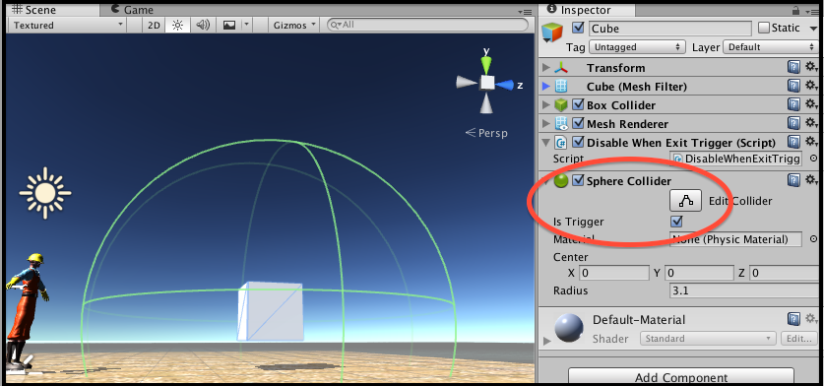
1B. Reducing the number of enabled objects by disabling objects whenever possible - additional
The following screenshot illustrates a large sphere collider having been created around the cube, with its Trigger enabled:

Slide 24
1B. Reducing the number of enabled objects by disabling objects whenever possible - additional
Many computer games (such as Half Life)
use environmental design such as corridors to optimize memory usage by loading and unloading different parts of the environment.
For example,
when a player hits a corridor trigger, environment objects load and unload.

Slide 25

1C. Reducing the number of active objects by making objects inactive whenever possible
Sometimes,
we may not want to completely remove an object, but it is possible to go one step further than disabling a scripted component by making the parent GameObject that contains the scripted component inactive.
This is just like deselecting the checkbox next to the GameObject in the Inspector, as shown in the following screenshot:

Slide 26
Optimization 2
Minimize actions requiring Unity to perform "reflection" over objects and searching of all current scene objects

Slide 27
2A. Improving efficiency with delegates and events and avoiding SendMessage!
When events can be based on visibility, distance, or collisions,
we can use such events as OnTriggerExit and OnBecomeInvisible.
When events can be based on time periods,
we can use coroutines.
However, some events are unique to each game situation, and C# offers several methods of broadcasting user-defined event messages to scripted objects.

Slide 28
2A. Improving efficiency with delegates and events and avoiding SendMessage!
One approach is
the SendMessage(…) method,
which, when sent to a GameObject, will check every Monobehaviour scripted component and execute the named method if its parameters match.
However,
this involves an inefficient technique known as reflection.
C# offers another event message approach known as delegates and events.

Slide 29
2A. Improving efficiency with delegates and events and avoiding SendMessage!
Delegates and events work in a similar way to SendMessage(…),
but are much more efficient since Unity maintains a defined list of which objects are listening to the broadcast events.
SendMessage(…) should be avoided if performance is important,
since it means that Unity has to analyze each scripted object (reflect over the object) to see whether there is a public method corresponding to the message that has been sent;
this is much slower than using delegates and events.

Slide 30
2A. Improving efficiency with delegates and events and avoiding SendMessage!
Delegates and events implement
the publish-subscribe design pattern (pubsub).
This is also known as the observer design pattern.
Objects can subscribe one of their methods to receive a particular type of event message from a particular publisher.

Slide 31
2A. Improving efficiency with delegates and events and avoiding SendMessage!
C# publisher objects don't have to worry about how many objects subscribe to them at any point in time (it could be none or 1,000!);
this is known as loose coupling,
since it allows different code components to be written (and maintained) independently and is a desirable feature of object-oriented code.

Slide 32
Optimization 3
Call methods as few times as possible

Slide 33
3A. Executing methods regularly but independent of frame rate with coroutines
While it is very simple to put logic into Update() and have it regularly executed for each frame,
we can improve game performance by executing logic as rarely as possible.
So, if we can get away with only checking for a situation every 5 seconds,
then great performance savings can be made to move that logic out of Update().

Slide 34
3A. Executing methods regularly but independent of frame rate with coroutines
A coroutine is
a function that can suspend its execution until a yield action has completed.
One kind of yield action simply waits for a given number of seconds.

Slide 35
3A. Executing methods regularly but independent of frame rate with coroutines
Have different actions happening at different intervals
Coroutines can be used to have different kinds of logic being executed at different regular intervals.
So,
logic that needs frame-by-frame execution goes into Update(), and logic that works fine once or twice a second might go into a coroutine with a 0.5-second delay;
logic that can get away with less occasional updating can go into another coroutine with a 2- or 5-second delay, and so on.

Slide 36
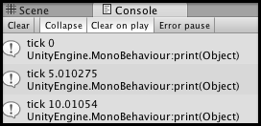
3A. Executing methods regularly but independent of frame rate with coroutines
In this project,
we use coroutines and yield to show how a method can be only executed every 5 seconds;
this could be useful for NPCs to decide whether they should randomly wake up or perhaps choose a new location to start moving toward.

Slide 37
3B. Spreading long computations over several frames with coroutines
Coroutines allow us to
write asynchronous code—
we can ask a method to go off and calculate something, but the rest of the game can keep on running without having to wait for that calculation to end.
Or, we can call a coroutine method for each frame from Update() and organize the method to complete part of a complex calculation each time it is called.

Slide 38
3B. Spreading long computations over several frames with coroutines
Note that coroutines are not threads,
but they are very handy in that each can progress each frame further.
It also allows us to write code that does not have to wait for certain methods to complete before another can begin.

Slide 39
Optimization 4
Use performance data to drive design and coding decisions

Slide 40
4A. Evaluating performance by measuring max and min frame rates (FPS)
A useful raw measurement of game performance is the maximum and minimum frame rate for a section of a game.
We can
make use of a Creative Commons Frames Per Second (FPS) calculation script to record the maximum and minimum frame rates for a game performing mathematics calculations for each frame.

Slide 41
Optimization 5
Minimize the number of draw calls

Slide 42
5A. Improving performance with LOD groups
Detailed geometry and high-resolution texture maps can be a double-edged sword:
they can deliver a better visual experience, but
they can impact negatively on the game's performance.
LOD groups address this issue by
replacing high-quality objects by simplified versions
whenever that object takes up a smaller portion of the screen than necessary for a high-quality version to make a significant difference.

Slide 43
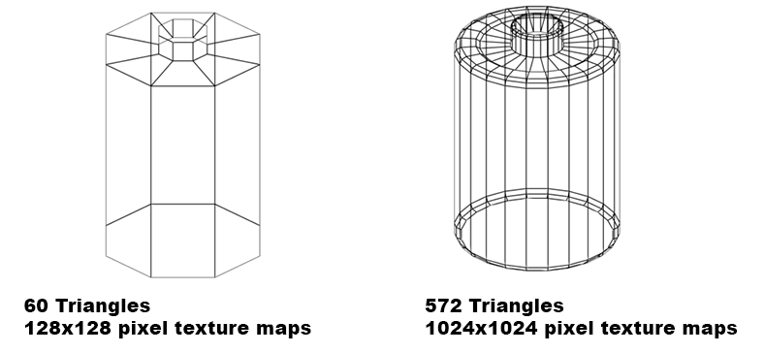
5A. Improving performance with LOD groups

Slide 44
Mini-Projects

Slide 45
2A. Improving efficiency with delegates and events and avoiding SendMessage!

Slide 46
2A. Improving efficiency with delegates and events and avoiding SendMessage!
In this project,
we'll have a manager class that will publish new events when UI buttons are clicked.
We'll create some UI objects,
some of which subscribe to the color change events, so that each time a color change event is published,
subscribed UI objects receive the event message and change their color accordingly.

Slide 47
2A. Improving efficiency with delegates and events and avoiding SendMessage!
1. Create a new 2D project.
2. Add the following C# script class ColorManager to the Main Camera:
using UnityEngine;
using System.Collections;
public class ColorManager : MonoBehaviour {
public void BUTTON_ACTION_make_green(){
PublishColorEvent(Color.green);
}
public void BUTTON_ACTION_make_blue(){
PublishColorEvent(Color.blue);
}
public void BUTTON_ACTION_make_red(){
PublishColorEvent(Color.red);
}
public delegate void ColorChangeHandler(Color newColor);
public static event ColorChangeHandler onChangeColor;
private void PublishColorEvent(Color newColor){
// if there is at least one listener to this delegate
if(onChangeColor != null){
// broadcast change color event
onChangeColor(newColor);
}
}
}

Slide 48
2A. Improving efficiency with delegates and events and avoiding SendMessage!
3. Create two UI Image objects and two UI Text objects.
Position one Image and Text object to the lower left of the screen and
position the other to the lower right of the screen.
Make the text on the lower left read Not listening, and
make the text on the right of the screen read I am listening.
For good measure,
add a Slider UI object in the top right of the screen.

Slide 49
2A. Improving efficiency with delegates and events and avoiding SendMessage!
4. Create three UI buttons in the top left of the screen,
named Button-GREEN, Button-BLUE, and Button-RED,
with corresponding text reading
make things <color=green>GREEN</color>,
make things <color=blue>BLUE</ color>, and
make things <color=red>RED</color>.

Slide 50
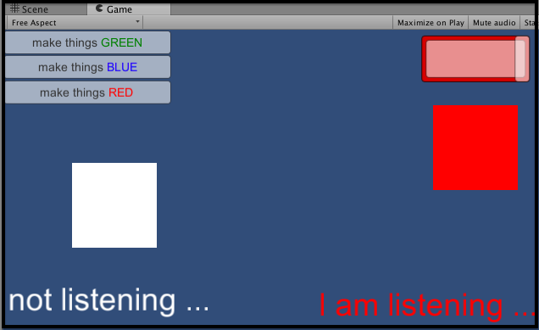
2A. Improving efficiency with delegates and events and avoiding SendMessage!

Slide 51
2A. Improving efficiency with delegates and events and avoiding SendMessage!
5. Attach the following C# script class ColorChangeListenerImage to both the lower-right Image and also the Slider:
using UnityEngine;
using System.Collections;
using UnityEngine.UI;
public class ColorChangeListenerImage : MonoBehaviour {
void OnEnable() {
ColorManager.onChangeColor += ChangeColorEvent;
}
private void OnDisable(){
ColorManager.onChangeColor -= ChangeColorEvent;
}
void ChangeColorEvent(Color newColor){
GetComponent<Image>().color = newColor;
}
}

Slide 52
2A. Improving efficiency with delegates and events and avoiding SendMessage!
6. Attach the following C# script class ColorChangeListenerText to the I am listening Text UI object:
using UnityEngine;
using System.Collections;
using UnityEngine.UI;
public class ColorChangeListenerText : MonoBehaviour {
void OnEnable() {
ColorManager.onChangeColor += ChangeColorEvent;
}
private void OnDisable(){
ColorManager.onChangeColor -= ChangeColorEvent;
}
void ChangeColorEvent(Color newColor){
GetComponent<Text>().color = newColor;
}
}

Slide 53
2A. Improving efficiency with delegates and events and avoiding SendMessage!
7. With button-GREEN selected in the Hierarchy,
add a new On Click() event for this button,
dragging the Main Camera as the target GameObject and
selecting public function BUTTON_ACTION_make_green().
Do the same for the BLUE and RED buttons with functions BUTTON_ACTION_make_blue() and BUTTON_ACTION_make_red() respectively.

Slide 54
2A. Improving efficiency with delegates and events and avoiding SendMessage!
8. Run the game.
When you click a change color button,
the three UI objects on the right of the screen show all changes to the corresponding color,
while the two UI objects at the bottom left of the screen remain in the default White color.

Slide 55
4A. Evaluating performance by measuring max and min frame rates (FPS)

Slide 56
4A. Evaluating performance by measuring max and min frame rates (FPS)
1. Start a new project, and import the FPSCounter.cs script.
2. Add the FPSCounter script class to the Main Camera.
3. Add the following C# script class SomeCalculations to the Main Camera:
using UnityEngine;
using System.Collections;
public class SomeCalculations : MonoBehaviour {
public int outerLoopIterations = 20;
public int innerLoopMaxIterations = 100;
void Update(){
for(int i = 0; i < outerLoopIterations; i++){
int innerLoopIterations =
Random.Range(2,innerLoopMaxIterations);
for(int j = 0; j < innerLoopIterations; j++){
float n = Random.Range(-1000f, 1000f);
}
}
}
}

Slide 57
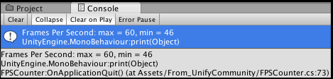
4A. Evaluating performance by measuring max and min frame rates (FPS)
4. Run the game for 20 to 30 seconds.
On the screen, you should see the current average and the maximum and minimum frame rates displayed.
5. Stop the game running.
You should now see in the Console a summary message stating the max and min frames per second, as shown in the following screenshot:

Slide 58

4A. Evaluating performance by measuring max and min frame rates (FPS)
Turn off runtime display to reduce FPS processing
We have added an option so that you can turn off the runtime display, which will reduce the processing required for the FPS calculations.
You just have to un-check the Display While Running checkbox in the Inspector.

Slide 59
5A. Improving performance with LOD groups

Slide 60
5A. Improving performance with LOD groups
1. Import the LODGroup package into your project.
2. From the Project view, inside the LOD folder,
drag the batt-high prefab into the Hierarchy view.
Then, do the same for the batt-low prefab.
Make sure that they are placed at the same Position (X: 0; Y: 0; Z: 0).
3. From the Create drop-down menu in the Hierarchy view, create a new empty game object (Create | Create Empty). Rename it battLOD.

Slide 61
5A. Improving performance with LOD groups
4. Add the LODGroup component to battLOD (menu Component | Rendering | LODGroup).
5. Select the battLOD object, and,
from the Inspector view, LODGroup component, right-click on LOD 2 and delete it
(since we'll have only two different LODs: LOD 0 and LOD 1),

Slide 62
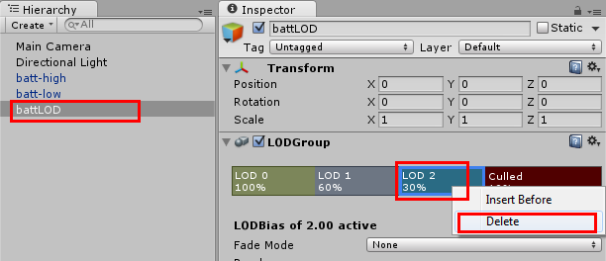
5A. Improving performance with LOD groups

Slide 63
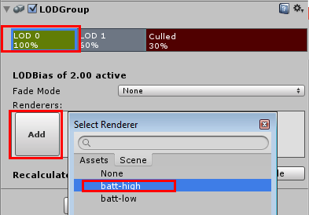
5A. Improving performance with LOD groups
6. Select the LOD 0 area, click on the Add button, and select the batt-high game object from the list.
A message about reparenting objects will appear. Select Yes, Reparent.

Slide 64
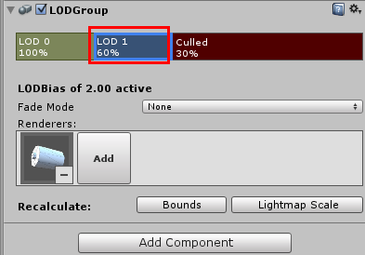
5A. Improving performance with LOD groups
7. Select the LOD 1 section, click on Add, and select the batt-low object.
Again, chose Yes, Reparent when prompted.

Slide 65

5A. Improving performance with LOD groups
8. Drag the limits of the LOD renderers to set them as:
LOD 0: 100%,
LOD 1: 50%,
Culled: 1%.
That will make Unity render bat-high whenever it occupies 51 percent to 100 percent of the screen space, batt-low when 2 percent to 50 percent, and will not render anything if 1 percent or less.

Slide 66
5A. Improving performance with LOD groups
9. Move the scene's camera toward the battLOD object and back.
You will notice how Unity swaps between the high- and low-definition LOD renderer as it occupies more or less than 50 percent of the screen's space.

